Slide 1
The Networker
March 8, 2025
Michel Biezunski, Infoloom
WIAD, New York City
mb@infoloom.com

Slide 2
What is the Networker?
Platform to ingest, curate and publish taxonomies and knowledge graphs
Super-easy to use. Can handle complex situations.
Open Import/Export features
Usable as standalone or as middleware
Cloud-based, 5++ years of development

Slide 3
Design Principles
Human brain is not tabular.
We can freely associate any thought with another. Our intelligence is not artificial.
Sometimes, it is important to access precise and accurate data that represents real facts.
Tech is designed to help humans, instead of enslaving them.
Multiple perspectives can coexist using the same data.

Slide 4
The Networker vs. AI
The Networker ingests data from various inputs. AI-based tech is one of them.
Curation tool
Analysis (Patterns), and custom scripts
Manual (user-friendly user interface)

Slide 5
Where does the Networker come from?
Topic Maps architecture (ISO/IEC 13250)
Designed as a replacement for a knowlege tool used by the US government until 2019.
Differs from:
RDF/Semantic Web tools for taxonomies, ontologies, knowledge graphs
Data analysis products.
AI, GenAI, LLMs

Slide 6
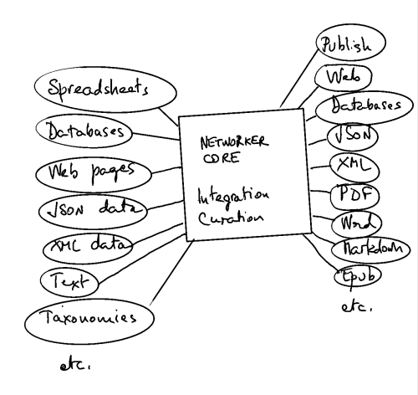
Use Cases
Individual Use. Thoughts Organizer
Data Integration and Mapping
Data Curation and Cleaning
Knowledge Base Sharing & Publishing

Slide 7
Starting from Scratch
Create topics and relationships as you go.
Notes:
Use: NY - NY State - USA - North America - America
Add Texas and California.

Slide 8
Curation
Synonyms
Split

Slide 9
Taxonomies
Example:
Geographic

Slide 10
Views
Relations as topics
View by Relations
Graph View

Slide 11
Next Steps
Open-sourcing in progress.
Creation of a Networker Users Group
Infoloom Role:
Provide Consulting Services and Cloud-based installs
Custom developments for clients.

Slide 12
Links
https://networker.infoloom.com
https://infoloom.com

